Slide 1

Social Learning Theory: Bobo Doll
ATPSY Year 12 ATAR Psychology

Slide 2

Review
Exam Questions:16 minutes

Slide 3
Learning Intentions
study: ‘Bobo doll’ experiment (Bandura, Ross and Ross, 1961)

Slide 4
Success Criteria
Describe the procedures, findings and ethics of the Bobo Doll experiment.

Slide 5
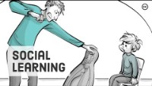

Slide 6
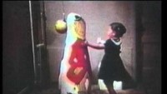

Slide 7
Strengths of the study
The findings from the study have been very influential in finding out whether media violence has an impact on children’s behaviour
The experiment took place in a laboratory, therefore all variables were well controlled
The experiment has proven easy to replicate and has been carried out many times, with similar results since the 1960s.

Slide 8
Weaknesses of the study
Children may have shown demand characteristics, which means that they displayed the behaviour that they thought the researcher was looking for
The study lacks ecological validity, as it took part in a laboratory
The research only looks at short-term behaviour and may not reflect children’s behaviour in the long term
The study took place with an imitation doll; aggression may have been different with a real person who would likely have retaliated.

Slide 9
Success Criteria
Describe the procedures, findings and ethics of the Bobo Doll experiment.

